Slide 1
Analysis of Deep Progressive Reinforcement Learning for Skeleton-based Action Recognition
By Phong Nguyenho

Slide 2
Reinforcement Learning
Computational approach of learning from action

Slide 3
Progressive Reinforcement Learning
The ability to incorporate prior knowledge at each layer of the feature hierarchy
The ability to reuse old computations and learn new ones

Slide 4
Deep Progressive Reinforcement Learning
Deep seems to just mean many layers

Slide 5
Convolutional Neural Network
Input/Output layer
Pooling – building layers using output data from previous layers
Fully connected layer– connects every neural node in a layer to the previous layers nodes
Update weights at the end

Slide 6
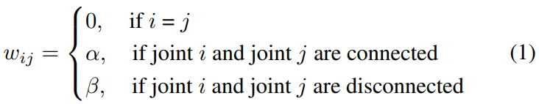
The first equation is explaining how the graph or rather the array is going to be constructed/filled. It is 0 if the two joints are the same joint. It is a value α if the joints are connected and a value β if the joints are disconnected. This seems to be a 2D array in code. α is used to tell that the joints are dependent on each other and β is used to say that the two joints are independent from each other.

Slide 7

Zt is a convolutional layer
y(η, W) is the kernel
* is the operator
Each graph/adjacency matrix is passing through this equation and a layer Zt is produced.

Slide 8

Zt is then fed to a fully connected layer which is denoted as gt where t is the time or frame of the video.
gt is then concatenated to form a feature map G of the input video.
G is a 3D tensor (rank 3 tensor) otherwise known as a cube or 3D array.
The cube is the pre trained GCNN.

Slide 9
η ∈ [η0, η1..., ηK−1] are the parameters to be trained
T is the time/frames.
This equation explains how convolutional layer equation (2) works.

Slide 10
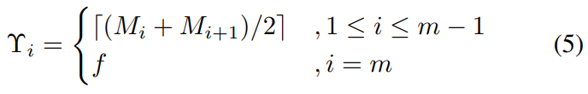
Array of size m where m is number of frames
This equation defines the upper bound for the frame adjustment
M is a tensor and it implicitly provides the FDNet with knowledge about which frames of the video are selected.
The upper bound of the frame adjustment is set to be the middle between one frame and the frame next to it in the selected frame set

Slide 11
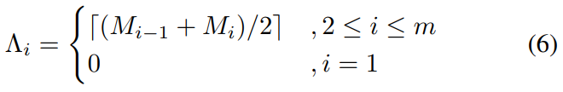
Array of size m where m is number of frames
This equation defines the lower bound for the frame adjustment
M is a tensor and it implicitly provides the FDNet with knowledge about which frames of the video are selected.
The upper bound of the frame adjustment is set to be the middle between one frame and the frame next to it in the selected frame set

Slide 12

This is an equation of the frame adjustment
M is a tensor and it implicitly provides the FDNet with knowledge about which frames of the video are selected.
M’ is the adjustment
δ is the frame shift

Slide 13
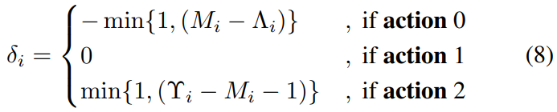
The shift amount is determined by the type of action which is determined by the sampled states
If it is action 0 then there is a shift left, if it is action 1 then the there is no shift, and if it is action 2 then there is a shift right.
For action 0 it returns a negative number that is either 1 or the tensor minus the lower bound whichever is smaller.
For action 1 it returns a 0 because the state is staying the same.
For action 2 it returns a positive number that is either 1 or the upper bound minus tensor minus the lower bound whichever is smaller.

Slide 14
r0 takes value in {−1, 1}, reflecting the predicted possibility improvement of the ground-truth action
Pn,c represents the probability of predicting the video as class c at the nth iteration
c is the ground truth label of the video
sgn is a sign/signum function

Slide 15
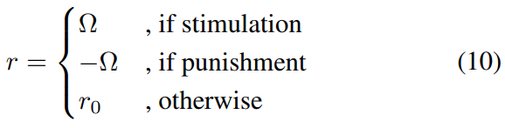
A strong stimulation of r = Ω is enforced when the predicted action turns from incorrect to correct after one iteration
A strong punishment of r = -Ω is enforced when the predicted action turns from correct to incorrect after one iteration
Return r0 if it is the predicted action doesn’t turn after one iteration.

Slide 16
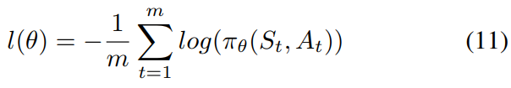
This equation is to compute the cross entropy loss which is needed in order to maximize the discounted reward R
m is the selected frames
S is the state
A is the action 0, 1, 2

Slide 17

θ is updated in this equation

Slide 18
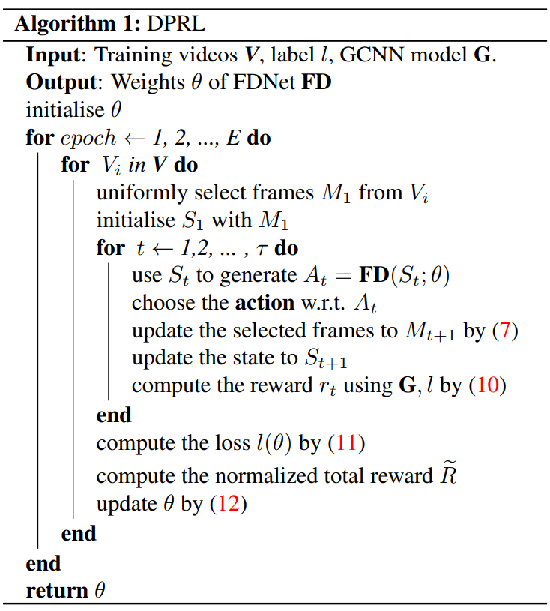
Input the videos, action label, and pre trained GCNN which is calculated from equations 1 – 4. The GCNN provides the rewards for the FDNet and FDNet selects key frames for refining GCNN. The better GCNN is, the more accurate rewards will be provided. The higher quality the selected frames have, the better GCNN can be refined.
At the test time, each video goes through the FDNet to produce its corresponding sequence with the informative frames, which will be finally sent into the GCNN to provide the action label.
For each period, go through the videos and select frames to initialize the first state, then for go through a loop t for 7 times because it’s stated in the paper. T is the number of adjustments. As the loop goes through 7 times, use the state to generate the probability of it being an action. Then choose the action with respect to the probability calculated. Update the selected frames to by the frames adjustment equation (7). Also update the state. Compute the rewards using the GCNN.
After the t loop is done then compute the cross entropy loss to maximize the discounted reward. Then compute the normalized total reward and update the weights of FDNet. Then repeat for every video.
Repeat the loops for every epoch.

Slide 19
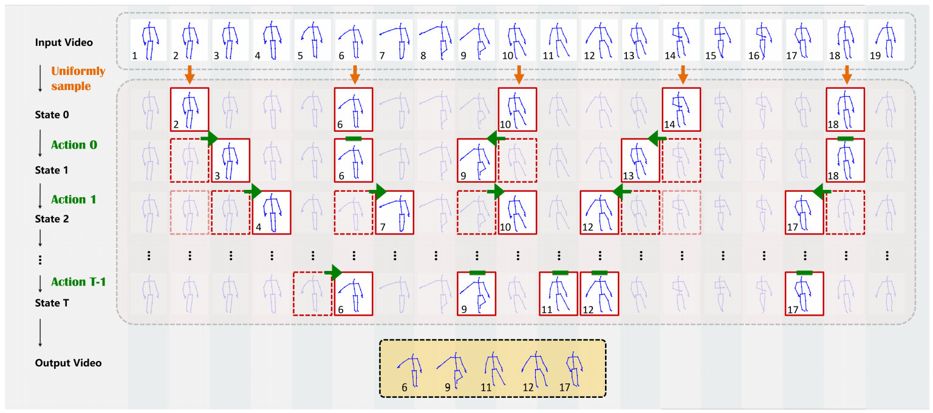
Selects a frame and then initialize the first state.
Uses the state to generate the probability of an action
Choose the action with respect to its probability
Update the frame and state
Compute rewards
Repeat until adjustments are finished
Get output video

